Slide 1
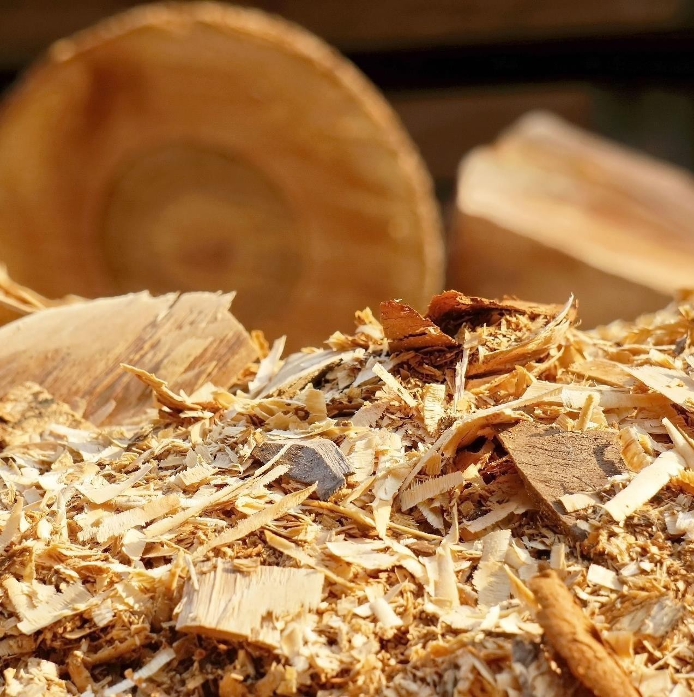
INVESTMENTS IN AN INDUSTRIAL SAWMILL COMPLEX
BELARUS
2025

Slide 2
INVESTMENT OPPORTUNITY

Slide 3
PROJECT DESCRIPTION
BR-Wood LLC was established in Bobruisk in July 2018 to implement the investment project "Organization of a new sawmill and pellet production". The main goal of the project is to manufacture products for export.
Stage 1
Stage 2
The construction concept of sawmill and pellet production, developed by SIA Timberlift, provides for two stages:
Construction of a sawmill with the processing of about 200 thousand m3 of raw materials per year, the planned capacity of pellet production is 35 thousand tons of finished products per year
Increasing the capacity of sawmill production to: 500 thousand m3 of processed raw materials per year, pellet production - up to 70 thousand tons of finished products
The estimated capital cost of the project is 44.77 million euros excluding VAT (during the implementation of the first stage, the purchase of equipment will include the second stage**)
The estimated capital cost of the project is 11 million euros excluding VAT.
Stage 1 will be implemented in 2025, reaching its design capacity from the end of 2026.
** The capacity of individual units and aggregates will be designed to double productivity without incurring capital costs:
Log feed line;
Sawmill waste disposal and storage system;
Transport and conveyor systems of sawmill and pellet production;
A source of thermal energy for pellet production;
A line of packing pellets in 15-kilogram bags and 1,000 kg big bags.
6

Slide 4
OFFER TO PARTNER / INVESTOR – TRANSACTION STRUCTURE
Currently, the participant of BR-Wood LLC is considering the possibility of attracting a strategic investor/partner to the project, who will have the appropriate technological, financial and sales competencies.
A potential Partner/Investor is offered the following tentative transaction structure to obtain a controlling stake in BR-Wood LLC*:
1.
The minimum capital investment is approx. 4 million euros in the form of cash-in.
2.
In addition, in order to obtain a controlling stake in BR-Wood LLC, it is necessary to purchase shares from the project participant for the amount to be determined based on the evaluation negotiations.
In order to obtain a controlling stakein BR-Wood LLC, it is necessary to provide financing in the amount to be determined based on the cash-in valuation negotiations, which will be aimed at replacing bank financing.
OR
* The initiator of the project is also ready to consider other mechanisms for the participation of a potential Partner / Investor and the structure of the transaction, including the possibility of selling a larger share or the entire business.

Slide 5
ECONOMIC FEASIBILITY AND ATTRACTIVENESS OF THE PROJECT FOR THE PARTNER/INVESTOR
1.
High profitability and return on investment project (IRR – 20%).
2.
The possibility of processing large-diameter (24-50 cm) wood, which is not in demand by other large lumber producers in the country due to the lack of suitable sawmill production facilities.
3.
The possibility of producing lumber of rare parameters (due to the use of large-diameter wood), which can be sold at a premium on the market.
4.
The possibility of organizing the production of CLT panels as part of Stage 3 of production development, which is already in the process of developing the concept .
5.
Access to labor, due to the location of the site in a large city of Belarus next to another existing woodworking enterprise.
6.
Availability of raw materials and proximity to raw material zones.

Slide 6
ECONOMIC FEASIBILITY AND ATTRACTIVENESS OF THE PROJECT FOR A PARTNER/INVESTOR
7.
The project is already in the process of implementation with a completion plan in 2025, including all necessary permits and expertise.
8.
The availability of access railways and the location of production facilities provides logistical advantages in terms of supplies to Europe, as well as the opportunity to participate in the development of new geographical export destinations (for example, to China, taking into account the current growth in container traffic in this direction).
9.
The issued credit lines for the implementation of the project, which can be maintained (assuming long-term repayment terms) or refinanced by a potential investor/partner.

Slide 7
PROJECT DESCRIPTION

Slide 8
THE CURRENT STATUS OF THE PROJECT IS STAGE 1 AND STAGE 2
Capital expenditures for STAGE 1 of the project are estimated at 44.77 million euros excluding VAT. The capital expenditures for STAGE 2 of the project are tentatively estimated at 11 million euros excluding VAT.
Progress of the main stages of the project (Stage 1) - implemented: |  | Progress of the main stages of the project (Stage 2) – in the process of implementation:
Completed in April of the 21st year
The land was allocated, a certificate of state registration of the land was obtained and a lease agreement was signed.
The suppliers of equipment for sawmilling are Belarusian JSC FanDOK (Springer sawmill sorting system, equipment has already been delivered to the construction site, equipment modernization is planned) and Swedish USNR AB (supply of a production line for the manufacture of lumber, equipment is supplied)
Until December 2024
Completed in June of the 22st year | Hot-water heat-tube solidfuel boilers have been manufactured, the equipment has been installed, and thermal communications are being laid.
The project documentation has been developed taking into account stage C (construction). The developer of the project documentation is LLC "Injspetsstroyproekt".
Completed in July of the 21st year
Completed in September of the 21st year
The drying equipment is manufactured and supplied by Katres (Czech Republic).
2025
Expected Project completion date

Slide 9
POTENTIAL DEVELOPMENT OPPORTUNITIES - STAGE 3
Predefined parameters
Organization of additional production of CLT panels (furniture panel, timber).
The required area for the organization of the production of CLT panels is approx. 0.5 ha
The preliminary investment volume, including the purchase of basic equipment, auxiliary and power equipment, as well as construction and installation work (including dismantling), is about 20 million euros.
The market value of 1 m3 of CLT panels is retail 730-800 euros, wholesale 600-700 euros
CLT panels or panels made of cross-glued wood are a modern building material, from which load-bearing supports and beams, floor slabs and wall panels are made.
Glued timber is a high–tech structural material made of several layers of wooden lamellae (fragments, boards), which are first folded into bags of the required thickness, and then glued together under a press.
A furniture board is a wooden billet for the production of furniture from dry, glued lumber. It is used for the manufacture of cabinet furniture.
Panel production can be created to generate more revenue by producing products with a higher degree of processing and higher added value, taking into account the existing demand for such products in foreign markets.

Slide 10
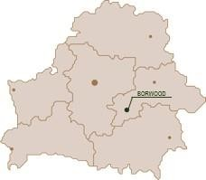
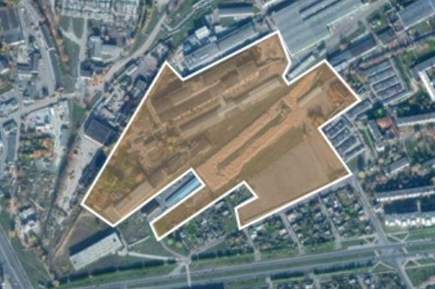
PRODUCTION PLACEMENT
The total area of the territory is 13 hectares (with the possibility of expanding the area to approx. 20 ha due to the joining of nearby plots).
The location of the production facility provides the company with a number of advantages:
Access to a workforce with relevant competencies (there are other existing woodworking industries)
Location on the territory of a built and fully functioning factory, Territorial proximity to many large customers within the country
Availability of railway access roads at the production site
Availability of export supplies to Europe, including Lithuania, Latvia, the Czech Republic, the United Kingdom, and Asia (China is a promising destination)
Convenient logistics of raw materials supplies
The location of the main components of production:
The sawmill and the lumber sorting and packaging line are located in the new building.
Drying chambers and a canopy for storing lumber are located on the site of the existing warehouse.
The pellet production is in a new building, with most of it being used as a finished goods warehouse.
The existing roundwood sorting line will also be located on the site, and a place for storing incoming raw materials will also be reserved.
The stock of sorted raw materials is supposed to be placed on a site with a concrete coating.

Slide 11
INFORMATION ON PROVIDING THE PRODUCTION SITE WITH INFRASTRUCTURE AND ENGINEERING NETWORKS
Engineering support
The new production facility plans to use engineering networks of JSC "FanDOK". Engineering communications comply with government regulations, regulations, standards, as well as technical specifications and requirements issued by supervisory authorities and interested organizations. There is also a crane farm on the territory of the plant.
Heat supply
The demand for thermal energy of the entire complex will be provided by its own boilers. Boiler house with a capacity of 9 MW at the design stage. The main type of fuel will be wood waste. The bulk of the thermal energy is used to ensure the drying process of wood in drying chambers.
Lighting
Outdoor lighting networks are provided for the main passageways, the internal production area, and the storage area for roundwood.
Water supply
Currently, the company's water needs are being met in two main areas: domestic drinking water supply is provided from two artesian wells with a capacity of 40 m3 per hour each; fire-technical water supply is carried out from the pumping station of the coastal intake from the Berezina River with a maximum capacity of 720 m3 per hour.
Power supply
The power supply is provided by RUE Mogilevenergo. The project provides for the construction of three TP. Power supply via a 6 kV line is provided from RP-26 of JSC FanDOK, along a 10 kV line from RP-79 of RUE Mogilevenergo.
Transport
Access roads provide for the provision of automobile (including fire) and railway transport to the enterprise.

Slide 12
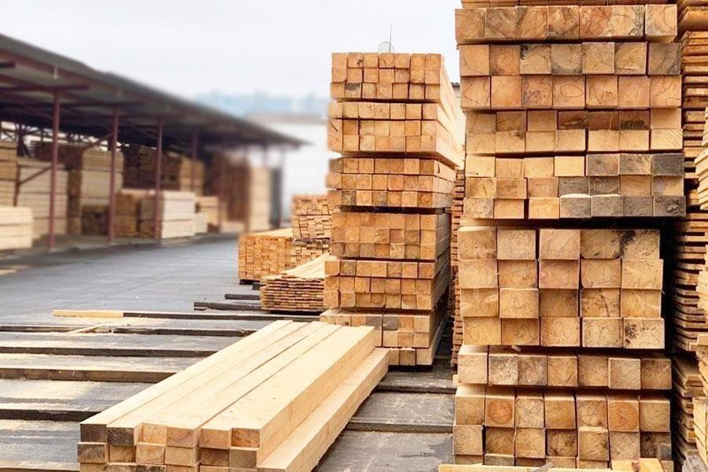
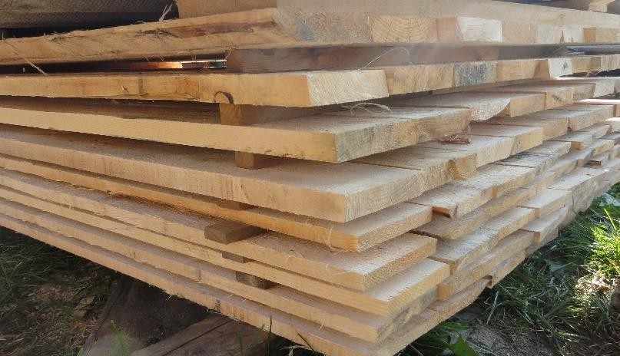
PRODUCT DESCRIPTION: LUMBER
The main products of sawmill production are sawn timber, which is produced during the longitudinal sawing of round logs. Additional products include technological chips, which are obtained by crushing lumpy waste: humps, slats and scraps.
The project provides for the production of the following lumber:
Edged lumber grade I-III
Edged lumber grade I-IV
Exports (about 90% of the production volume)
Domestic market (about 10% of the production volume)
Multi-level quality control:
1st control on the sawmill sorting system,
2nd – on the saw blade feed system in the saw (metal detector),
3rd – quality control of raw lumber in the sorting,
4th – after drying (dry lumber on the sorting line).

Slide 13
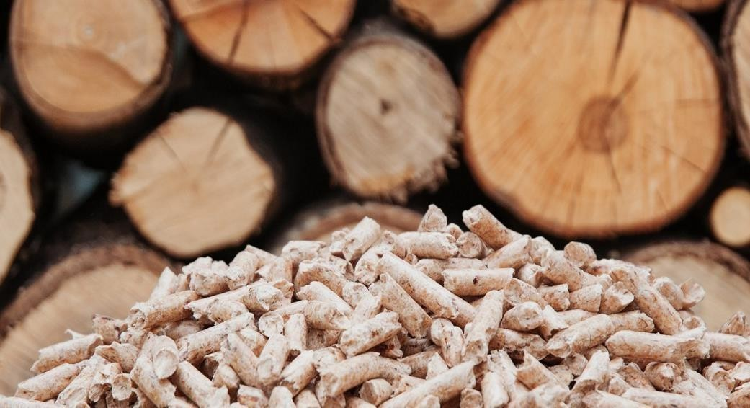
PRODUCT DESCRIPTION: PELLETS
Pellets are an alternative to traditional fuels such as firewood, peat, fuel oil, diesel and heating oil, and coal.
18
The project provides for the production of the following pellets Enplus A1:
Bulk fuel pellets (Big Bag, 1 ton each)
Fuel pellets packed in 15.25 kg
Exports (about 60% of the production volume)
Domestic market (about 40% of the production volume)
The design capacity (stage 1 and stage 2) is 70 thousand tons of pellets per year, reaching the design capacity is planned from the end of 2026.
Parameter | Unit of measurement | Indicator
Diameter | мм | 6 and 8
Length | мм | 12-40
Volume weight | кg/м³ | more than 600
Total moisture | massive % | less than 10
Lower heat of combustion | kWh/kg | more than 4,6
Ash content | massive % | less than 0,7
The raw materials for the production of pellets can be wood waste: bark, sawdust, wood chips and other waste from logging and wood processing, as well as firewood and commercial wood.
The production of pellets is carried out without the use of any chemical additives, which ensures the ecological purity of the fuel.
Quality control will be multi–level: for pellets – laboratory equipment (mixture control), final - after granulation.

Slide 14
MARKET AND REGULATORY ENVIRONMENT

Slide 15
TIMBER STOCKS AND HARVESTING
General indicators of the forest fund of the Republic of Belarus (at the beginning of the year)
According to the data of the forest cadastre, all the basic parameters of the forest fund of the Republic of Belarus increased significantly and annually in 2014-2020:
Indicator | units. | 2014 | 2015 | 2016 | 2017 | 2018 | 2019 | 2020 | 2020/2014
Forest Fund lands | kha | 9 477,1 | 9 499,5 | 9 549,2 | 9 565,8 | 9 582,0 | 9 598,5 | 9 620,9 | +143,8
Forested lands | kha | 8 160,4 | 8 204,2 | 8 239,8 | 8 259,4 | 8 260,9 | 8 256,9 | 8 280,3 | +119,9
Woodiness | % | 39,3% | 39,5% | 39,7% | 39,8% | 39,8% | 39,8% | 39,9% | +0,6 п.п.
Total stock of plantings | MMm³ | 1 692,7 | 1 714,3 | 1 739,9 | 1 772,5 | 1 796,0 | 1 807,9 | 1 831,8 | +139,1
Coniferous trees | MMm³ | 1 131,2 | 1 144,6 | 1 160,8 | 1 182,3 | 1 194,9 | 1 197,6 | 1 206,8 | +75,6
Hard - faced | MMm³ | 57,9 | 58,5 | 59,0 | 59,5 | 60,0 | 61,0 | 61,9 | +4,0
Soft - leaved | MMm³ | 502,7 | 510,4 | 519,2 | 529,8 | 540,2 | 548,6 | 562,3 | +59,6
Total stock of plantings available for operation | MMm³ | 1 372,8 | 1 387,7 | 1 411,2 | 1 439,0 | 1 459,8 | 1 469,4 | 1 528,8 | +156,0
Average stock of plantings | m³/ha | 207 | 209 | 211 | 215 | 217 | 219 | 221 | +14
Helpers | m³/ha | 264 | 267 | 269 | 273 | 276 | 279 | 283 | +19
Ripe and overpowered | m³/ha | 254 | 256 | 260 | 264 | 267 | 272 | 272 | +18
Average age | year | 54 | 54 | 55 | 55 | 56 | 56 | 56 | +2
Forest fund lands increased by 143.8 thousand hectares
The area of forested lands increased by 119.9 thousand hectares
The forest cover of the territory increased by 0.6 percentage points.
The total reserve of plantings increased by 139.1 million m3, available for operation – by 156 million m3.
The stock of coniferous plantations increased by 75.6 million m3, hard–leaved – by 4 million m3, soft-leaved - by 59.6 million m3
The average stock of plantings increased by 14 m3/ha
The average age of the plantings increased by 2 years
Volume of liquid wood harvested by all types of logging, million m3
30,0
25,0
20,0
15,0
10,0
5,0
0,0
The volume of liquid wood harvested in Belarus by all types of logging is growing annually and in 2019-2020 amounted to about 27 million m3 per year.
1995 2000 2005 2006 2007 2008 2009 2010 2011 2012 2013 2014 2015 2016 2017 2018 2019 2020
23

