Slide 1
“Krasny Rog” is a tourist complex in Belarus
A brief overview of the investment opportunity
February, 2026

Slide 2
Overview of the complex
Brief description: the complex is designed as a family hotel with appropriate infrastructure (restaurant, playgrounds, and a SPA area). For off-season use, a conference hall is planned for various MICE events. The complex is located 3 km from the Minsk-Polotsk highway (R46), 20 km from Polotsk, and 200 km from Minsk.
Plot area: 5 ha
House types: studios – 5pcs, 1+1 – 10pcs, double houses – 2pcs (the calculation of the number of houses is based on the attached financial model. The territory allows for an increase of up to 25 pcs)
Restaurant: 80 seats
Conference hall: up to 100 people
SPA area: steam room, recreation room, massage room, year-round swimming pool (a gas pipeline is located 50m from the complex)

Slide 3
All houses, regardless of their type, will be designed in a unified architectural style.

Slide 4
Key project indicators
The project is included in the state program "Tourist
potential", which provides for preferential financing at 6% per annum for up to 15 years.
The investment volume is 4.41 million Belarusian rubles.
The project implementation period is June 2029.
The project payback period is 6.5 years.
The net profit after the launch of the entire complex is from 600,000 rubles per year.
* - The calculations of payback periods and net profit indicators are based on 100% bank financing.

Slide 5
About the company implementing the project
The Krasny Rog complex is our second project. We have designed, built, and launched the Mesto Hotel (https://hotelmesto.by/?ysclid=mlt3zsk9bv213451702 ), which is also located in the Polotsk district of the Vitebsk region. The hotel has been operating for 3 years. Currently, there are 10 houses, a mini-spa, and a space for events of up to 25 people. The main target audience of the current hotel is couples, so there is no significant flow of guests from one hotel to another. A significant audience in the Instagram of the hotel "Mesto“ (https://www.instagram.com/hotel_mesto/) - more than 27 thousand subscribers for February 2026 - will allow you to quickly and absolutely free to advertise the new complex. The data for the financial model of the new complex is taken on the basis of the performance indicators of the hotel "Mesto" and correlated to new input data. The new complex is located 5km from the hotel "Mesto", which will allow you to organize the guests' meals for the time until your own restaurant is built.
An important aspect of the new project is the full support of the local administration, as well as the management of the local branch of the largest bank in Belarus, Belarusbank.

Slide 6
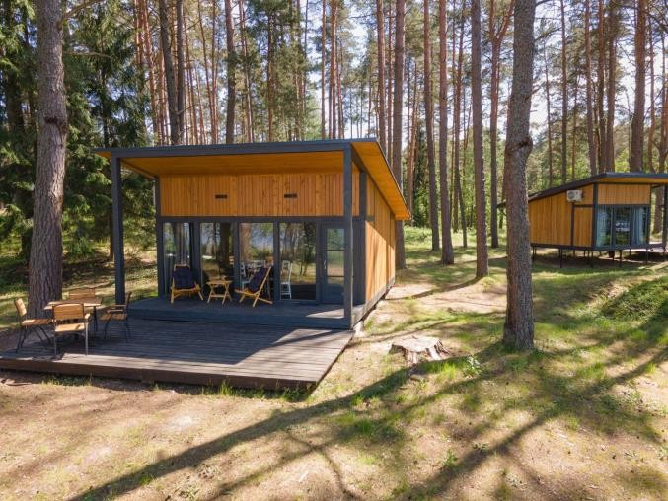
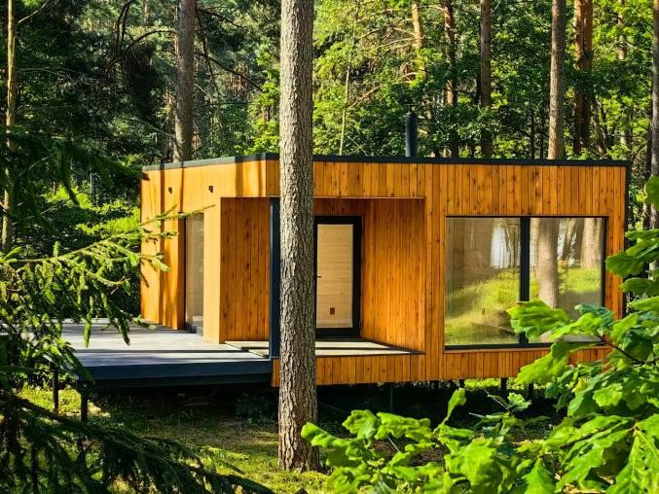
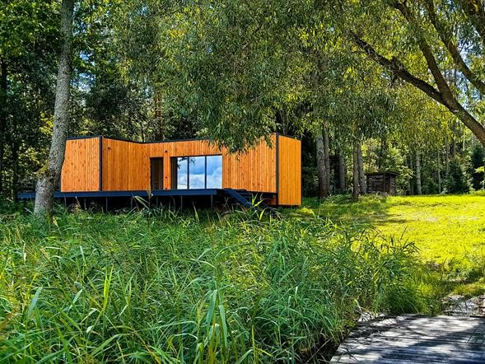
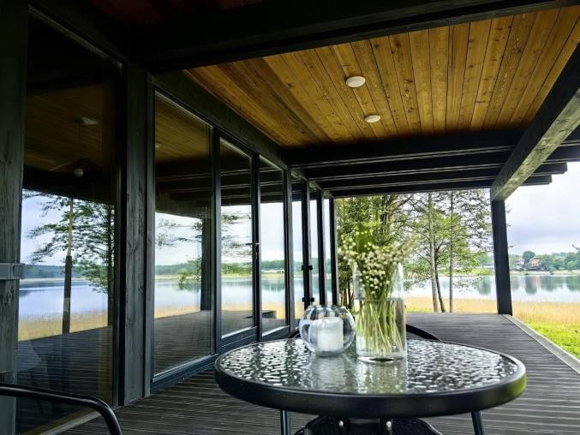
Hotel “Mesto”
Room stock
Room stock
Mini SPA
Event space

Slide 7
Contacts
Sergey Supranovich
Managing Partner of the Mesto Hotel
Director and founder of Bilit LLC,
which implements the Krasny Rog project
Phone: +375 29 765 00 62

