Slide 1
Sale of the production and warehouse complex in Nesvizh

Slide 2
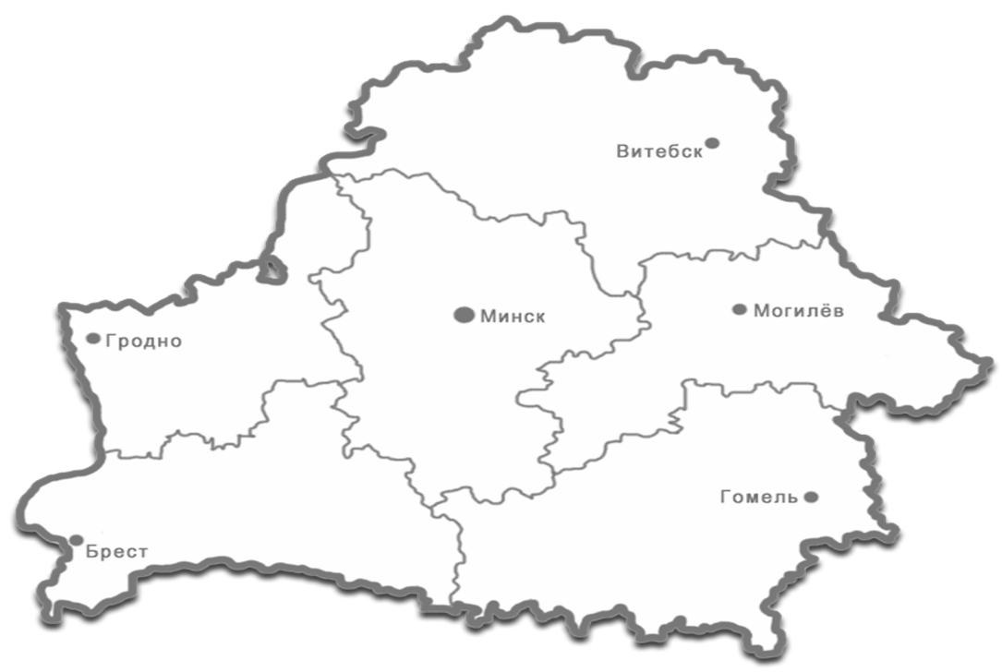
JSC "Krinitsa" offers for sale the production and warehouse complex in Nesvizh
The complex includes the following objects: 9 buildings 8 specialized facilities Landscaping and utility infrastructure Water reservoirs Movable property
*Further in the presentation, a detailed description of the objects will be provided.
Vitebsk
Minsk
Mogilev
Grodno
Gomel
Brest

Slide 3
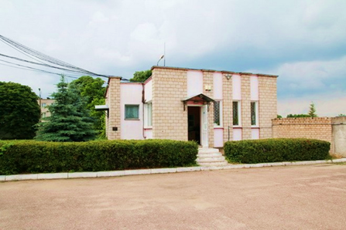
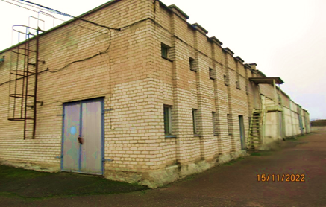
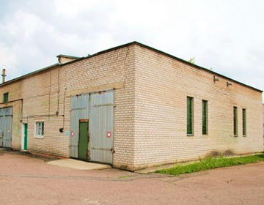
The following objects of the production and warehouse complex are offered for sale:
Checkpoint and entrance gate
Specialized building.
Year of construction – 1996.
Total area – 66,5 м².
Building of the auxiliary block
Specialized building.
Year of construction – 1995.
Total area – 1138,5 м².
Vehicle wash facility for beer trucks
Building of processing industry.
Year of construction – 1995.
Total area – 113,6 м².

Slide 4
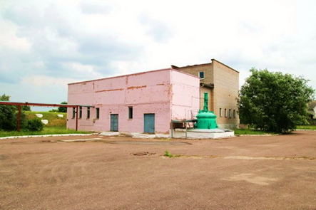
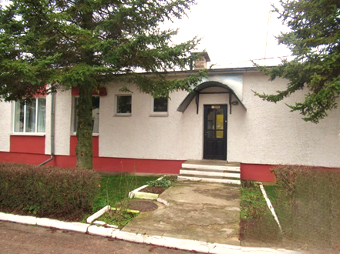
Pumping station over the artesian well
Building of processing industry.
Year of construction – 1995.
Total area – 50,1 м².
Drying workshop
Building of processing industry.
Year of construction – 1954.
Total area – 264,2 м².
Components and accessories:
the single-story brick building of the drying workshop.
Building of the pumping and filtration station
Building of processing industry.
Total area – 254,6 м².
Components and accessories:
the single-story brick building of the pumping and filtration station.
Administrative building
Administrative and economic building.
Year of construction – 1973.
Total area – 322,3 м².

Slide 5
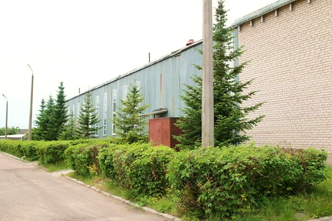
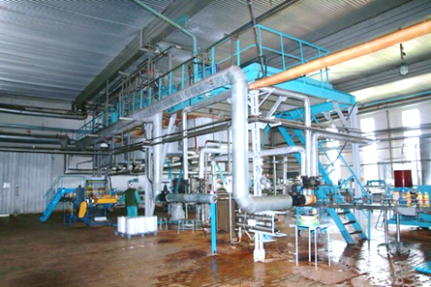
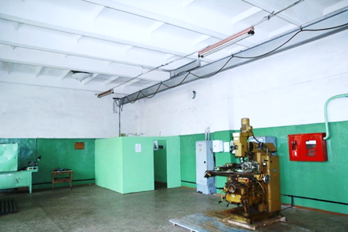
Main building
Specialized building for the production of food products, including beverages, and tobacco.
Year of construction – 1996.
Year of reconstruction – 2023.
Total area – 4055,3 м².
Components and accessories: main building, annexes, and canopies.
The main building contains the protective structure.

Slide 6
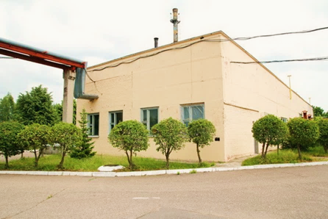
Boiler house building
Specialized building for energy purposes.
Year of construction – 1996.
Total area: 517 м².
Components and accessories:
Boiler house building, annex, chimney, saltwater pool.
Glass cullet facility
Specialized facility for processing industry.
Total area – 111,6 м².
Components and accessories:
a single-story concrete structure for the glass cullet facility.

Slide 7
Off-site and on-site water supply networks
Specialized facility for water management purposes.
Components and accessories:
off-site and on-site water supply networks consisting of:
drinking and fire-fighting water supply
plumbing of water after de-icing
running water for flushing filters
water supply and reception of recycled water, chemical water supply. softened water for production
re-water plumbing from filter cooling, Re-water plumbing from beer cooling
with a total length of 2994 м, cast-iron pipes, laid underground with an average depth of up to 2 м., including sixteen wells.
Power transmission cable facility
Specialized energy facility.
Components and accessories: power transmission cable facility D with a length of 1196,7 м, laid underground with the depth of up to 1 м.
Off-site and on-site sewage networks
Specialized facility for municipal services.
Components and accessories: off-site and on-site sewage networks L, K, with the total length of 2462,2 м.

Slide 8
Low-voltage wires of the industrial site
Specialized energy facility.
Components and accessories: construction of low-voltage industrial site networks B, H, consisting of: low-voltage electrical network B, outdoor lighting H, with a total length of 3028 м, underground laying method, laying depth up to 1 м.
Site heating networks
Specialized public utility building
Components and accessories: construction of on-site thermal networks T, 393 м., the method of laying ground-underground steel pipes with thermal insulation.
Gas pipeline networks
Specialized power engineering facility
Components and accessories: construction of the G gas pipeline network with a total length of 248 м, surface-underground laying method, laying depth up to 2 м., from steel pipes.
Also, movable property and objects of
the flora

Slide 9
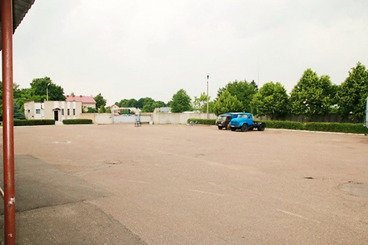
Flushing water tank
Components and accessories:
The flushing water tank, the laying method is above ground, the area is 27 м².
Filtered water tank
Components and accessories:
The filtration water tank is V 500 cubic meters, the method of laying (installation) is above ground, the area is 148,3 м².
Filtered water tank
Components and accessories:
The filtration water tank is V 500 cubic meters, the method of laying (installation) is above ground, the area is 151,5 м².
Landscaping
Components and accessories:
Driveways, Playgrounds, and Fences.
The area is 11 366 м².

Slide 10
The properties are located on the following land plots:
Land area of 5.21 ha
The intended purpose is for the construction and maintenance of buildings and structures.
RIGHTS RESTRICTIONS:
Restrictions on the rights to land plots located in protected areas of electrical networks with a voltage of up to 1000 volts, an area of 0.01 ha;
Restrictions on land plots located in protected areas of electrical networks with a voltage of up to 1000 volts (cable), area 0.1086 ha;
Restrictions on the rights to land plots located in protected areas of electrical networks with a voltage of over 1000 volts, an area of 0.0735 hectares. An artesian well is located on the land plot, the owner of which (UE "Soligorskvodokanal") has decided to liquidate it.
Land area of 0.36 ha
The intended purpose is the placement of industrial facilities. The right of permanent use. The transfer of the right to land plots is carried out in accordance with the current legislation of the Republic of Belarus.

Slide 11
Initial sale price: 3 777 759,14 belarus roubles (1,2 USD million) including VAT 20 %. Auction step: 5 %. The amount of the deposit: 200 000 belarus roubles (63 291 USD). Information about the seller: Open Joint Stock Company "Krinitsa" 220070, Minsk, 52 Radialnaya str., phone: 8(017) 299-22-22 e-mail: info@krinitsa.by, info@wines.by Contact person for communication and inspection of the facility: Fabian Vladimir Mikhailovich phones: + 375 1770 64 4 03 + 375 29 129 24 74 + 375 29 863 45 04 (24/7)

